Slide 1

Code Comment Classification Prepared By : 1705087 1705089
01

Slide 2
Problem definition

Slide 3
Problem definition
The Code Comment Classification is a competition to build and evaluate binary classifiers to classify class comment sentences into categories representing the type of information conveyed.
A dataset of 6738 sentences and 19 baseline classifiers will be provided. We must train, tune and evaluate their classifiers using provided sets.
Evaluation will be based on a formula that accounts for overall F1 score and proportion of classifiers outperforming baselines, with the goal of improving as many baselines as possible.

Slide 4
Dataset Analysis

Slide 5
Data Set Links
. These comments were extracted from 20 open-source projects
Java (2417): https://github.com/nlbse2023/code-comment-classification/tree/main/java/input
Pharo (1765): https://github.com/nlbse2023/code-comment-classification/tree/main/pharo/input
Python (2555): https://github.com/nlbse2023/code-comment-classification/tree/main/python/input

Slide 6
CSV Data Structure
The dataset is a collection of 6738 class comment sentences in CSV format, with one file per programming language in the input folder. Each row represents an instance and contains 6 columns:
Comment sentence id: a unique identifier for the sentence
Class : the class name of the sentence's source code file
Comment sentence: the sentence string from a multi-line class comment
Partition : dataset split into training and testing, 0 for training and 1 for testing.
Instance type : instance type: 0 for negative, 1 for positive instances..
Category : the ground-truth or oracle category.

Slide 7
Dataset Preparation
Converting sentences to lowercase, reducing multiple line endings, removing special characters except for a-z0-9,.@#&^%!? \n, replacing periods in numbers, removing extra spaces, and splitting comments into sentences preprocesses the dataset.
Dataset is split into 80/20 training-testing split
Using NEON extracts NLP features and creates term-by-document matrices.
Using Weka to classify the comment sentences using Random Forest model
Evaluation is done using standard evaluation metrics: precision, recall, and F1-score.

Slide 8
Proposed Solution

Slide 9

Proposed solution ( Initial)
Baseline models using Weka tools: Use Weka to train and test classifiers using algorithms such as Random Forest and SMR. Prepare NLP and TEXT features using NEON and TF-IDF
Additional classifiers: Use pre-trained models such as BERT, FastText, and Word2Vec to extract features and train classifiers. Compare with baseline models.
As an last additional step to the proposed architecture, we may add a neural network component and fine-tune them for better performance. We may be benefit from its ability to learn complex non-linear relationships and feature representations from raw data.

Slide 10
Main possible Challenges
The dataset provided for the competition may have an imbalance in the number of instances for each category, which can affect the performance of classifiers.
Understanding the domain and context of the class comments may be necessary to build accurate classifiers, but this knowledge may not be readily available
The dataset may contain a large number of features which can lead to difficulties like overfitting and poor performance of classifiers.
The class comments may contain noise such as irrelevant or redundant information, which can make it difficult for classifiers
The dataset provided for the competition is limited in size, which can make it difficult to train and evaluate
The evaluation metric may not well designed for the task

Slide 11
Loss Function & Its Intuition

Slide 12
Loss Function : Bayes, Function
Uses negative log-likelihood function i.e. cross-entropy loss.
Intuition behind this is to minimize the difference between the predicted probabilities of each class and the true labels of each sample.

Slide 13
Loss Function : Tree
Uses impurity-based metrics such as Gini impurity to measure the quality of a split in the decision tree.
Intuition behind impurity-based metrics is to minimize the overall impurity of the predicted class labels in each leaf of the decision tree.
The impurity of a node in the tree is defined as the measure of how mixed the labels in the node are.

Slide 14
Loss Function : Tree(cont.)
The loss function used in tree-based models is defined as the weighted sum of the impurities of the child nodes resulting from a split.
Goal of the tree-based model is to minimize the overall loss function by recursively splitting the data until each leaf node contains a homogenous class of samples.

Slide 15
Performance Report

Slide 16
Performance metrics
1
2
The overall F1 Score F1 score is a measure that balances precision and recall. Here we have to take into account the performance of each classifier across all categories. The higher the average F1 score, the better the performance of the classifiers.
Portion of classsifiers that improved We have to improve as many baseline classifiers as possible with formula calculates the proportion of classifiers .The higher the proportion of classifiers that improve the baseline classifiers, the better the performance of the classifiers.

Slide 17
Implemented solution (architecture)
Using Weka tools : Bayes Net , Naïve Bayes , Decision Stump, Random Forest
Building Model From Scratch : Fasttext , Pretrained Bert

Slide 18
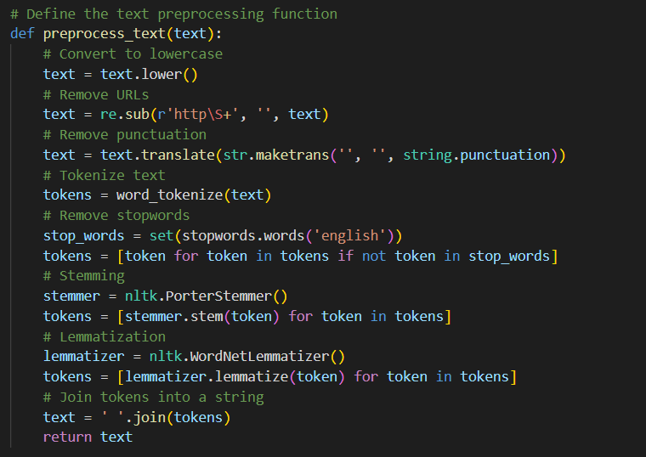
Preprocess

Slide 19
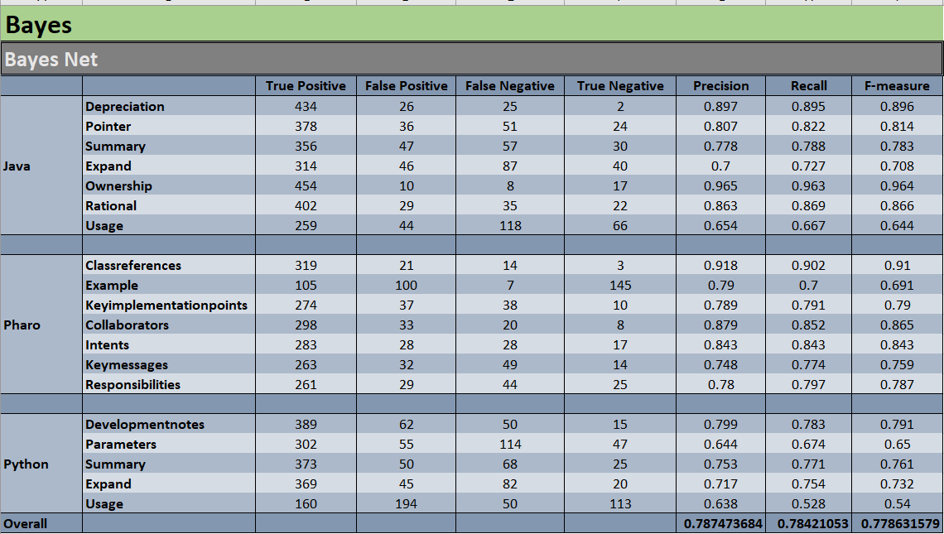
Model Experiment Result

Slide 20
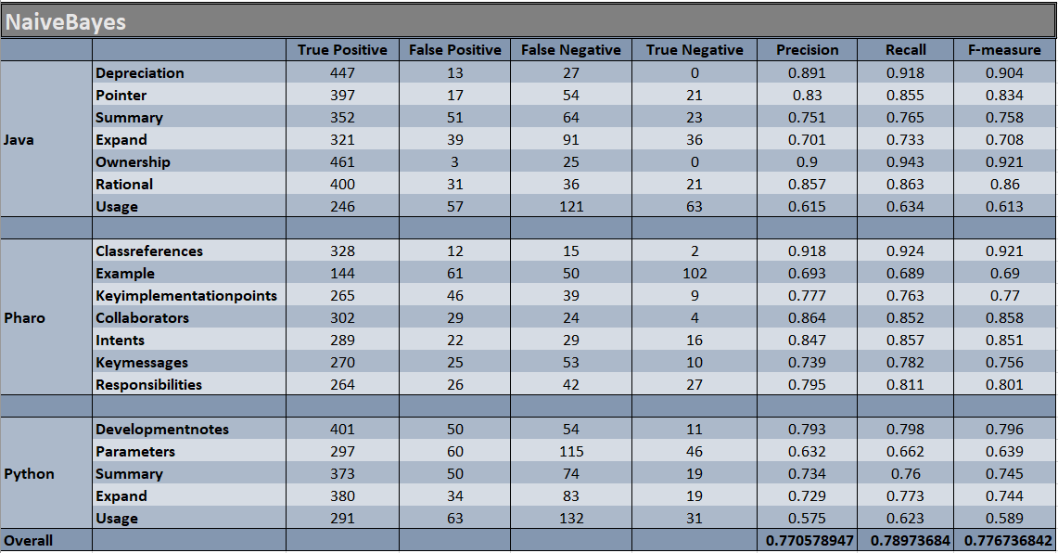
Model Experiment Result

Slide 21
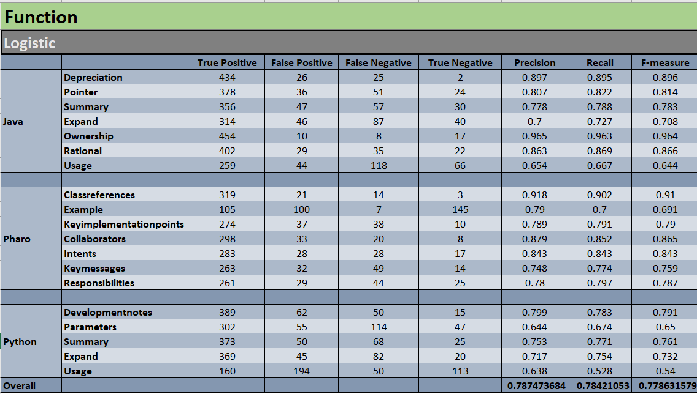
Model Experiment Result

Slide 22
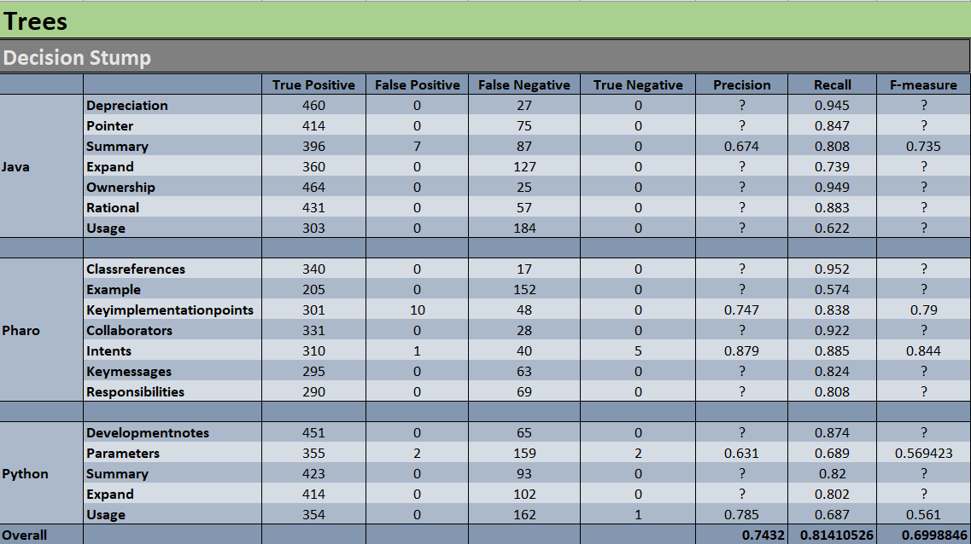
Model Experiment Result

Slide 23
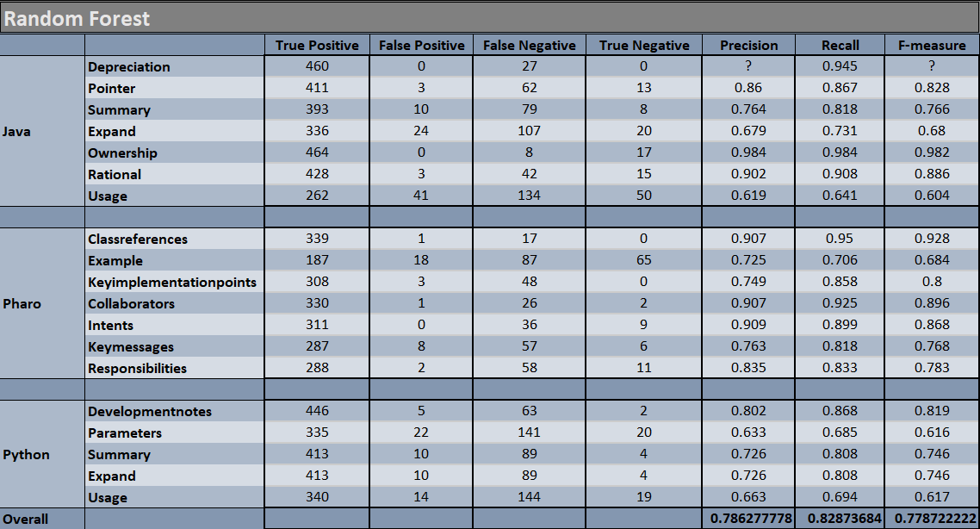
Model Experiment Result

Slide 24
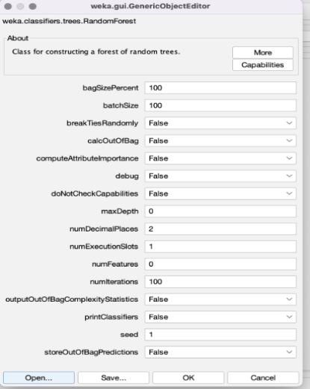
Random Forest Parameters

Slide 25
Analysis of Random Forest Model
It reduces overfitting, as the model is trained on multiple trees with different random subsets of data and features
Also handles missing data and outliers as well and is able to deal with high-dimensional datasets
As the Weka tool is using TF-IDS form of string vectorization, random forest is having an upper hand

Slide 26
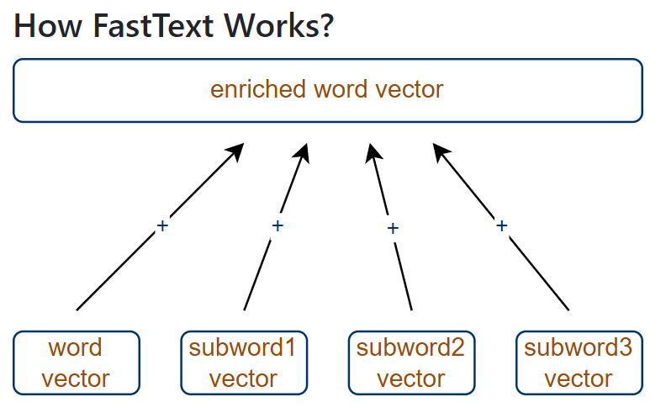
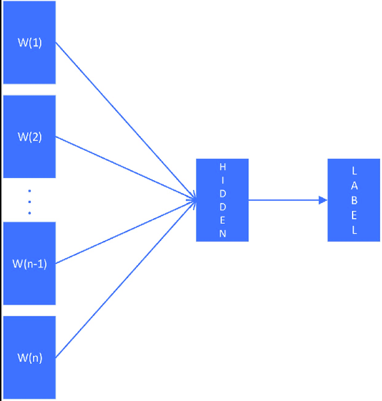
Pre-trained Fasttext Model

Slide 27
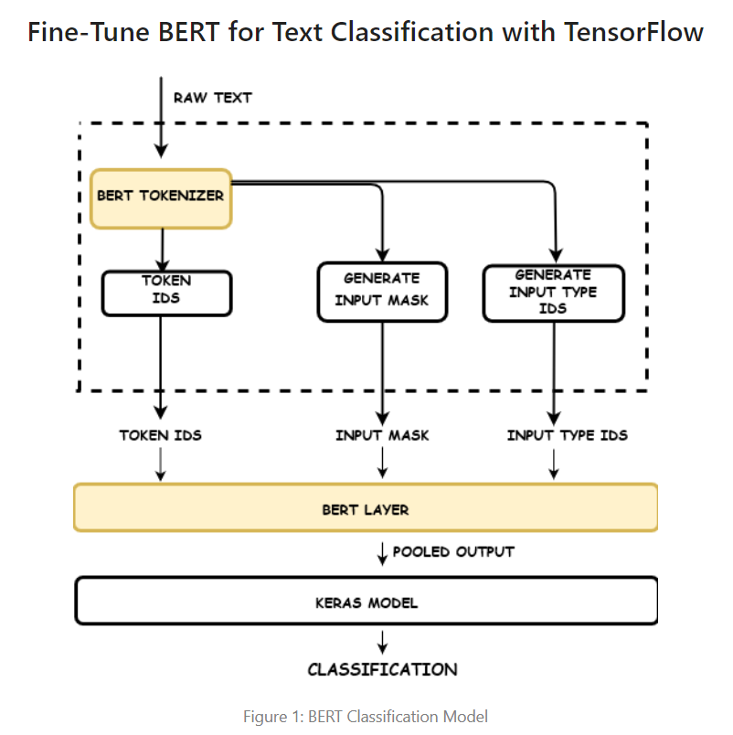
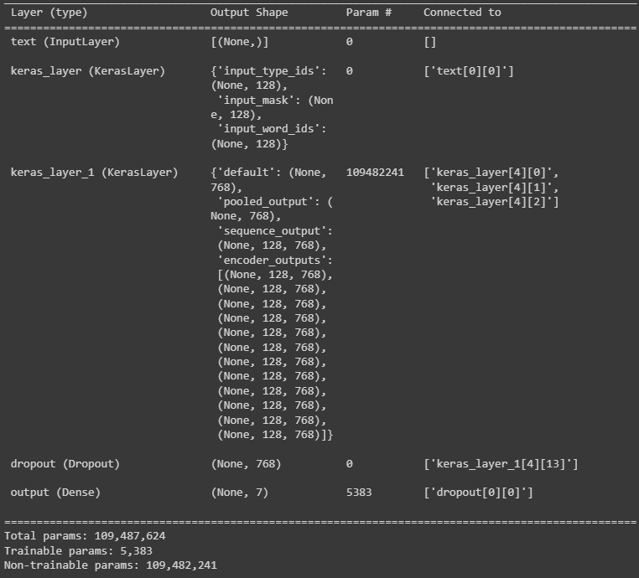
Pre-trained Bert Model

Slide 28
Layers in our Model (Bert)
This architecture is using the BERT language model as a pre-trained feature extractor for a text classification task. Here is a summary of the layers:
Input Layer: An input layer that takes in the text data.
Keras Layer: A layer that wraps the pre-trained BERT model, which takes in the text input and outputs the word embedding, attention mask, and segment embedding. These outputs are then used as inputs for the next layer.
Keras Layer Two: A layer that takes in the outputs from the previous layer and returns the encoder outputs, which are the contextualized embeddings for each token in the input sequence. These outputs are then used as inputs for the next layer.
Dropout: A dropout layer that randomly drops out a ten percentage of the encoder outputs to prevent overfitting.
Output Dense: A dense layer that takes in the encoder outputs and outputs a probability distribution over the possible classes using a softmax activation function. The number of units in this layer corresponds to the number of possible classes.

Slide 29
Loss (Fasttext and Bert)
The formula for categorical cross-entropy loss : -Σ(y * log(y_pred))
where y is the true probability distribution and
y_pred is the predicted probability distribution.
Categorical Cross-Entropy Loss :
- A popular loss function used in classification problems, where the output is a probability distribution over multiple classes
- It measures the difference between the predicted probability distribution and the true probability distribution of the classes

Slide 30
Loss (Fasttext and Bert)
Intuition :
The loss function is high when the predicted distribution is far from the true distribution, and low when they are close
The loss function penalizes the model more for making larger errors, which can help it converge to a better solution
Categorical cross-entropy loss is widely used because it works well with multi-class problems and encourages the model to predict a single class with high confidence
The goal is to minimize the distance between the predicted and true probability distributions.

Slide 31
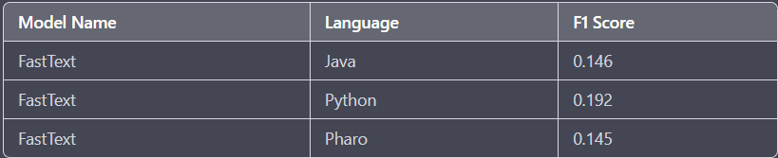
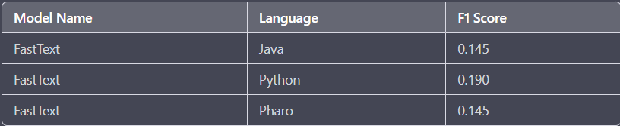
Performance report (Fastext )
Re- Pre-processing :

Slide 32
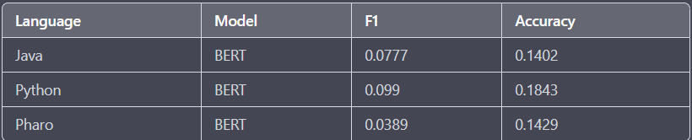
Performance report (BERT)
NB : The F1 score of BERT model is low due to the small dataset size,
which has caused overfitting or under-fitting issues.

Slide 33
Comparison with State-of-the-art Methods

Slide 34
Comparison with state-of-the-art methods
State-of-the-art methods for code comment classification use deep learning techniques such as transformer-based models like BERT, GPT-2, or XLNet, which have achieved impressive results in various NLP tasks, including code comment classification. These models can capture the complex relationships between words and phrases in the comments and provide highly accurate predictions. However, these models require large amounts of data and extensive training to achieve the best performance, which may not be feasible in all scenarios.
In our NLP code classification challenge, we explored different models such but among them Random Forest with TF-IDF, which provided good performance despite the limited size of the dataset. While our models may not match the performance of state-of-the-art models, they demonstrate that simpler models can be effective in certain scenarios and can provide valuable insights into the data. Furthermore, these models are faster and more computationally efficient, which may be important in real-world applications.

Slide 35
Challenges

Slide 36
Challenges / Discussion
In our NLP code classification challenge, we faced various obstacles. The dataset provided for the competition was limited in size, which made it difficult to train and evaluate our models accurately. We found that Random Forest with TF-IDF gave good performance despite the noise present in the comments data but Pre-Trained Fastext and Bert to give not expected F1 score because of overfitting and under-fitting issues .
Besides , We tried different preprocessing techniques such as tokenization, stemming, and lemmatization to remove the noise from the text data. However, some comments still contained irrelevant or misleading information, which negatively impacted the performance of our models. Overall, our experience in this challenge highlighted the importance of careful consideration of model architecture, feature engineering, and data size in dealing with the challenges of NLP.

Slide 37
References
https://keras.io/api/losses/probabilistic_losses/#categoricalcrossentropy-class
https://machinelearningmastery.com/multi-class-classification-tutorial-keras-deep-learning-library/
https://towardsdatascience.com/multi-class-text-classification-with-deep-learning-using-bert-b59ca2f5c613
https://towardsdatascience.com/fasttext-ea9009dba0e8

Slide 38
Thank you!
I’m so grateful for your patience

